Slide 1

Module 1 Project:
Behind the Glory
Amir, Mailys, Marco, & Sasha

Slide 2
Project Overview
Hypothesis
What do ‘successful’ countries at the Olympics have in common?
Breaking down potential winning components: GDP per Capita, Population, Host-effect, Star athletes
1
2
3
4
5
6
Define ‘success’ & how to measure it
Limiting project scope
Find supporting datasets
Clean-up & ‘re-building’ data
Crunching data & analysing results
Redefine as needed
1] Measure Olympic success by combined medal count [= Gold + Silver + Bronze]
2] Discussed potential winning aspects to research & analyse
Last 10 Olympic games
→ 1984 Summer LA, USA to 2024 Paris, FR
→ 1988 Winter Calgary, Canada to 2022 Beijing, China
Used 10 datasets
Sourced 8 Olympic-related csv files from Kaggle
&
2 from World Bank Group
After sourcing relevant datasets & getting familiar with the content → referenced scope to reduce the amount of data to work with
Taking the ‘cleaned’ data: combine, compound, break-down, compare, merge, & look for patterns to examine against the hypothesis
Life doesn’t always go according to plan; flexibility is required at each step to adapt or pivot when needed
Notes:
We were drawn to the Olympic topic for a few reasons: → data sourceability
→ contemporary & interesting topic
→ beginner-friendly data to practice with

Slide 3
Data Wrangling & Cleaning
Cleaning Process:
Drop unnecessary columns
Drop data before 1984
Dropped any country that was not an Olympic participant
Renaming columns and merging df
Data type change (numeric values)
Date data processing (split)
Filling nan (selected columns)
Drop remaining nan, less than 0.5%
→ Countries dataframe
→ Athletes dataframe
→ GDP dataframe
Significant Challenges:
→ inconsistent name of countries
→ processing dates
→ merging datasets from Paris 2024
Original Datasets → 10 csv files in total
8 Kaggle
4 csv files spanned Olympic historical data from 1896 - 2022
4 csv files covering the last 2024 Paris Olympics that matched up as well as possible to the historical data
2 World Data Group
1 csv file for global GDP per capita over time — for each year from 1960 to 2023 + for each country
1 csv file for global population numbers over time — for each year from 1960 to 2023 + for each country
pd.to_numeric errors=’coerce’

Slide 4
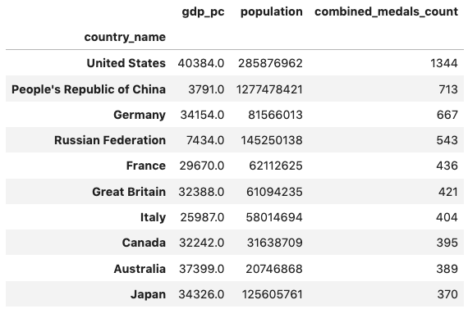
Exploratory Data Analysis
GDP per Capita & Population
Do Top Winning countries have a higher GDP per capita or higher population than the rest?
Top 10 Winners
None of the Top Winners are among the top 10 countries with highest GDP per capita ❌
But 4 are in the top 10 countries with highest population 👀
Nr. 1
Top Winners have a:
→ $ 27,777.50 avg. GDP per capita
→ 71,839,319 median population
Fun Fact
—----------
Out of a total of 10,576 medals, the T.W. won 5,682 of them
= 53%
👀
Versus
Total Olympic participating
countries have a:
→ $ 12,179.80 avg. GDP per capita
→ 6,389,235 median population
Over double GDP per capita [128% ↑]
Over 10x median pop. [11,138% ↑]

Slide 5
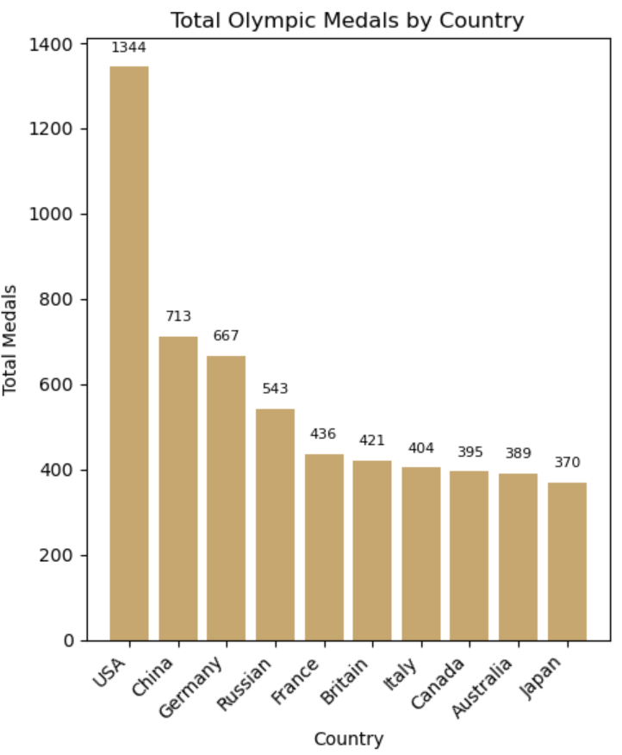
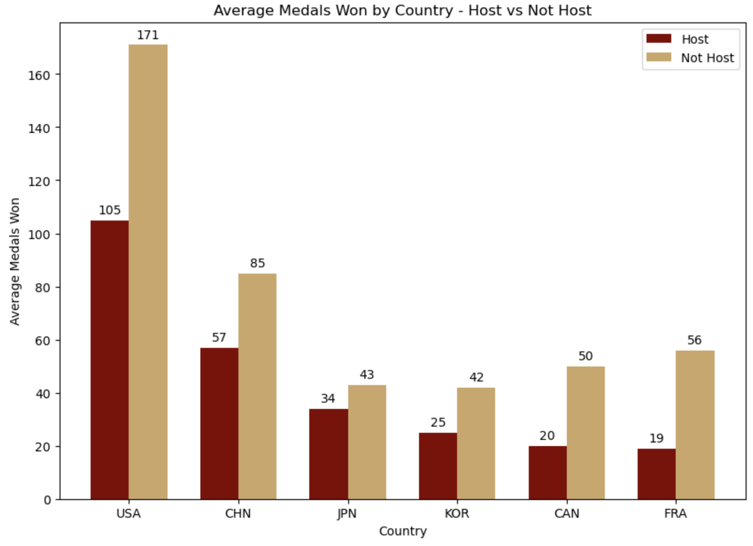
Exploratory Data Analysis
→ The graph showing the comparison of countries that hosted more than once.
→ The graph compares the medal counts when hosting V/s when not hosting the Olympics
Host Vs Not Host
Fun Fact
—----------
Total medals won are higher when the country is not hosting 😦

Slide 6
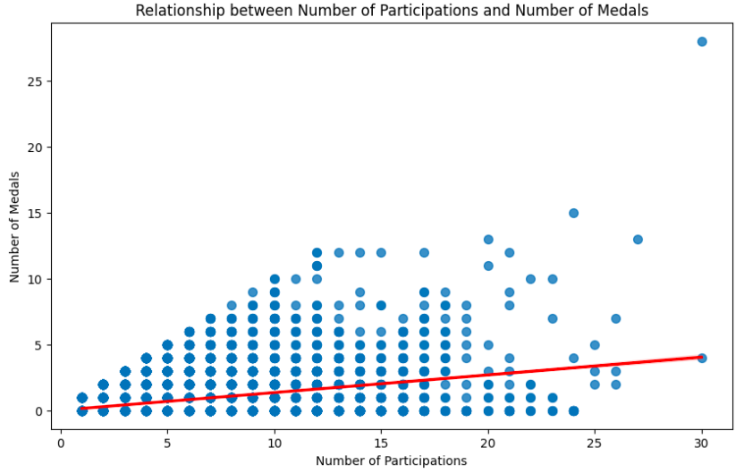
Exploratory Data Analysis
→ Relation between number of participations by athletes and number of medals
→ Red regression line shows the correlation : 0,364
→ Positive relationship, but not very strong.
→ Other factors play a significant role in medal success.
Fun Fact
—----------
Michael Phelps : 30 participations, 28 medals
Yordan Yovchev : 30 participations, 4 medals

Slide 7
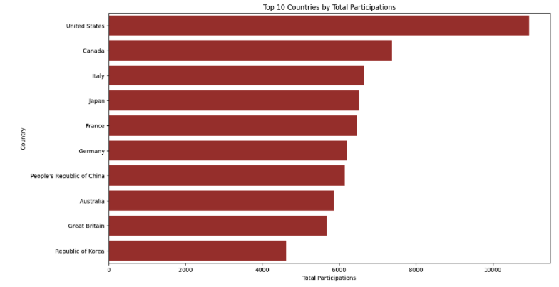
Exploratory Data Analysis
→ TOP 10 of countries with the highest participation rate
→ This graph shows the constant commitment and importance Of the Olympic Games over the Years
→ Indicator of country’s Investment in sport development

Slide 8
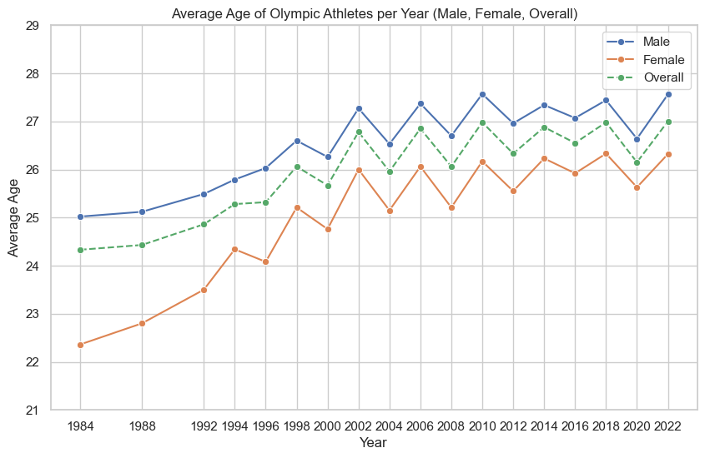
Exploratory Data Analysis
Age demographics
 | Female | Male
Average | 24.96 | 26.30
Overall avg | 25.77
Max | 66 | 71
Min | 11 | 12
Fun Fact
—----------
Youngest: Syria / Table tennis / 2020 Summer
Oldest: Bahamas / Sailing / 1988 Summer
Japan / Equestrian Dressage / 2012 Summer

Slide 9
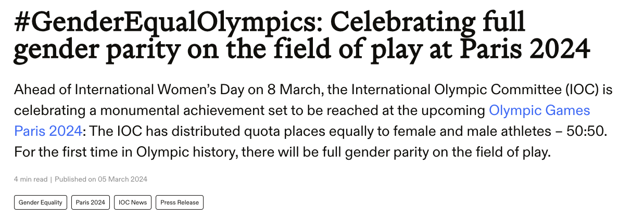
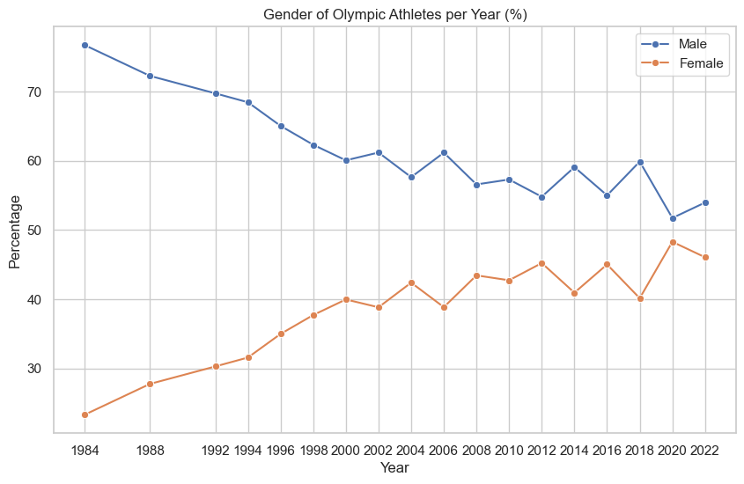
Exploratory Data Analysis
Gender demographics (gender gap)
Year | Female % | Male %
1984 (S) | 23.30 | 76.70
2020 (S) | 48.28 | 51.72
2022 (W) | 46.05 | 53.95
> The general gap between female-male participation has been closing through time.
> This gap is narrower in Summer editions than in Winter editions.
> The trend has continued and in 2024 it was reported a 50:50 split between female and male athletes.

Slide 10
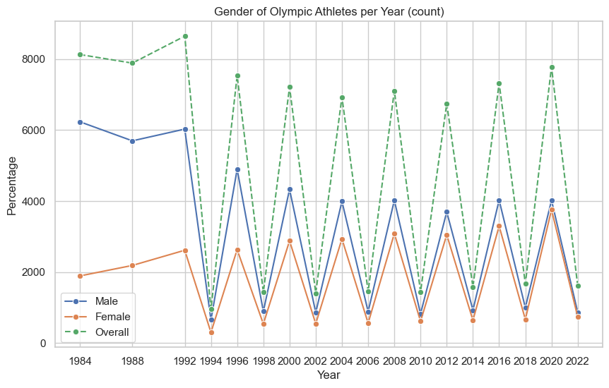
Exploratory Data Analysis
There is a radical change in the general trend after 1992… want to guess why?
Until 1992, summer and winter editions took place on the same year. So this trend shows the cumulative count from two editions on the same year.
Gender demographics (participation)
> Summer editions show stable trend of overall athlete participation close to 7 thousand.
> Winter editions have been increasing in overall athlete participation.
Summer | 1996 | 2008 | 2020
 | 7,534 | 7,111 | 7,779
Winter | 1994 | 2010 | 2022
 | 957 | 1,442 | 1609

Slide 11
Project Management
Strong initial project planning, ensured group is aligned to the project objective
Effective communication among the group, mutual understanding and acceptance of roles and responsibilities
The team displayed exceptional adaptability and receptiveness to feedback and new ideas
Major Obstacle
Navigating inconsistent data across different sources, with variations in names and date format, missing or incomplete records
Project timelines were impacted by the need to analyse data from both summer and winter editions separately of the Olympics, leading to delays
Paris Olympics data was incomplete and structured differently

Slide 12

Conclusion & Insights
We hypothesized that some winning components are at play, such as GDP per capita, population size, host effect, & star athletes
Au Revoir
→ GDP per capita & population are not deciding factors but do seem to be relatively present for top performing Olympic countries (further study required)
→ The host country analysis showed our hypothesis was false. Host countries win more medals when they do not host the Olympic Games. This could be biased due to the small sample size.
→ There is only a slight relationship between the number of participations per athlete and the total amount of medals won.
→ For participating athletes, the average age has increased over time, and the gender gap has been closing significantly in the last decades.
If you want a medal, you may have better chances coming from a country with higher GDP per capita & population, being in your mid 20’s and competing in a discipline with several events

